Slide 1
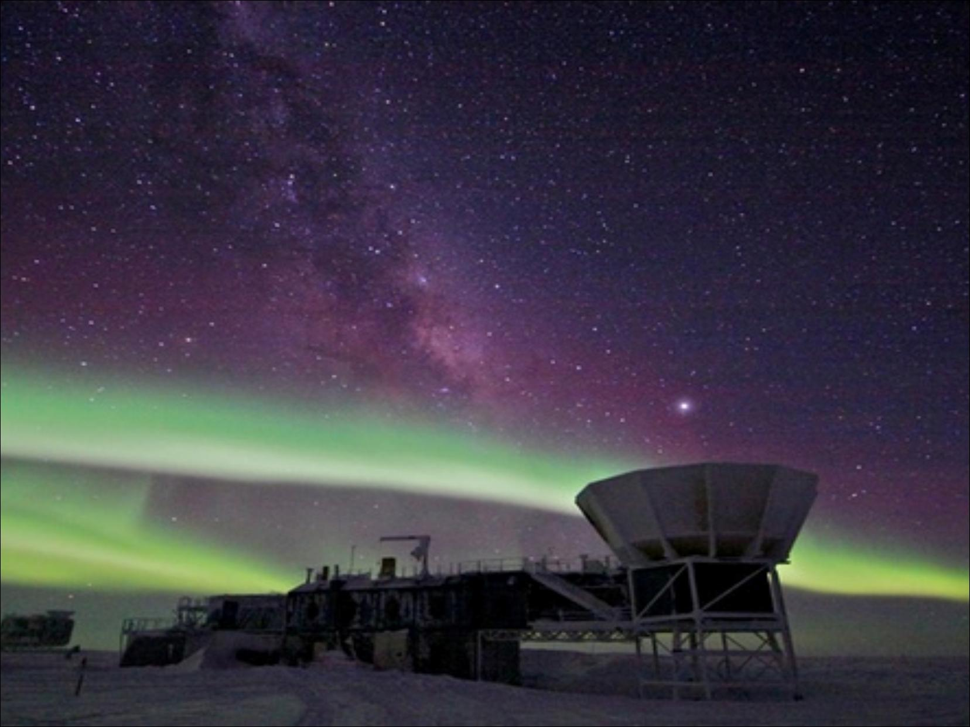
Gravitational Waves
The Child of General Relativity

Slide 2
A Necessary Change
Concepts before Einstein :-
There is a preferred reference frame ether
Time is absolute
3 dimensional universe
Concepts after Einstein :-
Time is not absolute
There is no ether frame
Notion of spacetime

Slide 3
Spacetime
Spacetime (also space–time, space time or spacetime continuum) is any mathematical model that combines space and time into a single Interwoven continuum.
Wikipedia
Event as a point in four dimension.
Space and time intervals of one coordinate system gets intermixed to give those intervals in another coordinate system.
Transformations in special relativity can be interpreted as rotation of coordinate system (realised by Minkowski).

Slide 4
'Crooked' and 'Straight'
Space was thought to be 'flat' or 'Euclidean'
In GR Einstein showed that spacetime gets curved in presence of mass.
Gravitation was interpreted as a consequence of curved spacetime.
Well, it was not a mere 'interpretation', it was a new physics. This model of gravitation gives different predictions than Newton's model.
Experiments confirmed that Einstein was correct.

Slide 5
Gravitational Waves
Gravitational waves are ripples in the curvature of spacetime that propagate as a wave, travelling outward from the source.
Wikipedia
Emerge as solution of Einstein's field equations in linear approximation.
There are both similarities and dissimilarities with EM waves.

Slide 6
Origin of GW
Curvature of spacetime depends on the mass per unit volume at any region.
When mass moves the curvature changes.
The changes of curvature due to accelerating object propagates at speed of light.
This is called gravitational wave.
Similar origin of EM waves.
Both travel at the speed of light (in vacuum)

Slide 7
Sources of GW
Accelerating mass provided its motion is not spherically or cylindrically symmetric
Two objects orbiting each other in a quasi-Keplerian planar orbit (basically, as a planet would orbit the Sun) will radiate.
A spinning non-axisymmetric planetoid — say with a large bump or dimple on the equator — will radiate.
A supernova will radiate except in the unlikely event that the explosion is perfectly symmetric.
An isolated non-spinning solid object moving at a constant velocity will not radiate. This can be regarded as a consequence of the principle of conservation of linear momentum.
A spinning disk will not radiate. This can be regarded as a consequence of the principle of conservation of angular momentum. However, it will show gravitomagnetic effects.
A spherically pulsating spherical star (non-zero monopole moment or mass, but zero quadrupole moment) will not radiate, in agreement with Birkhoff's theorem. Wikipedia

Slide 8

Some Properties
Gravitation is very weak compared to electromagnetic forces. So gravitational wave is hard to detect.
Gravitational waves comes in two types of polarizations: plus polarization and X polarization

Slide 9
Some Properties
It causes oscillating motion of bodies perpendicular to its direction of motion
Motion of beads placed perpendicular to plus polarized wave
Motion of beads placed perpendicular to cross polarized wave

Slide 10
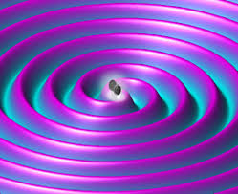
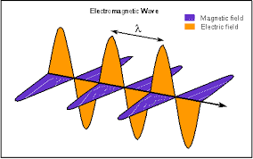
Differences with EM waves
Mathematically, EM waves arises as solution of Maxwell's equations without any approximation. But GW arises as solution in linear approximation.
GW are not absorbed by intervening medium. They can travel through matter of any composition or density.
Photons are themselves neutral. But gravitons themselves are massive. Mass is cause of gravitation. So the nonlinearity of field equations.

Slide 11
IMPORTANCE
One of the triumphs of general relativity
It will complete Big-Bang model
“Other than finding life on other planets or directly detecting dark matter, I can’t think of any other plausible near-term astrophysical discovery more important than this one for improving our understanding of the universe,” Caltech theoretical physicist Sean Carroll

Slide 12
GRAVITATIONAL WAVE DETECTION

Slide 13
Gravitational Waves
Emitted by a massive object, or group of objects, whose shape or orientation changes rapidly with time
Changes the geometry of space in a time-varying way
Strength and polarization depend on direction relative to source
Can be a linear combination of polarization components
“Plus” polarization
“Cross” polarization
Circular polarization

Slide 14
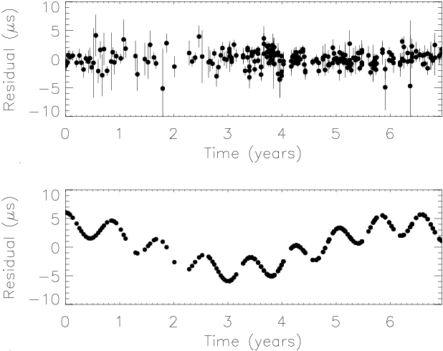
GW Detection I – Indirect
Binary pulsars
Observe binary systems with optical & radio telescopes.
See changes in orbit due to loss of energy to GWs.
Best test of GR to date – J1915+1606 (Hulse/Taylor Nobel Prize 1993), J0737-3039.
Pulsar timing
GWs propagating across line of sight from a pulsar to an observer change light travel time.
See this time shift in pulse timing.

Slide 15
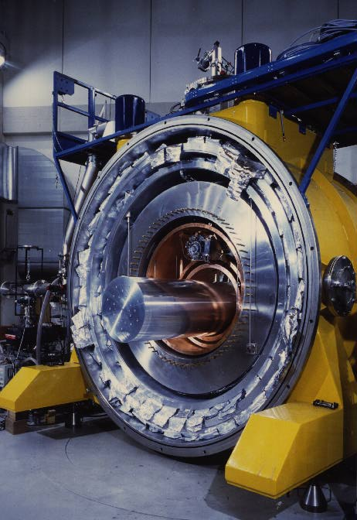
GW Detection II – Resonant Bars
A large cylinder of metal resonates when bathed in gravitational waves of the right frequency.
Detectors must be suspended to give seismic isolation. Cryogenic cooling reduces thermal noise.
First ever GW detector was a resonant aluminium bar. Today there are several increasingly sophisticated experiments in operation –
ALLEGRO (US), AURIGA (Italy), EXPLORER (CERN), NAUTILUS (Italy), NIOBE (Australia), GRAIL (Netherlands)

Slide 16
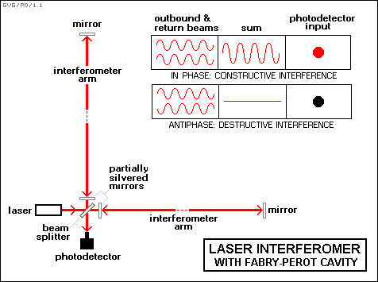
GW Detection III – Interferometers
Interferometers exploit quadrupole nature of GWs – send laser beams in perpendicular directions and combine them on return to construct interference patterns.

Slide 17
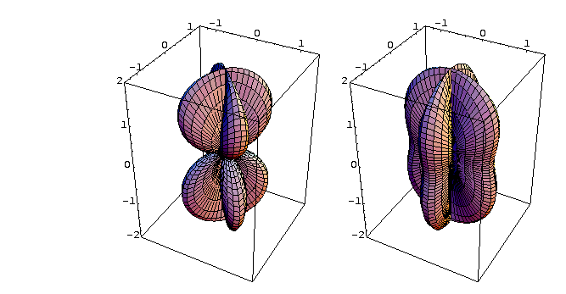
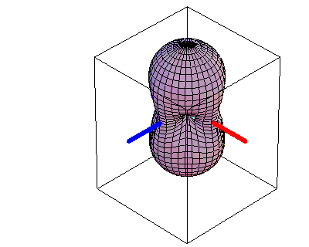
Laser Interferometers
Measure difference in arm lengths to a fraction of a wavelength
Responds to one polarization component
Antenna Pattern of a Laser Interferometer
Directional sensitivity depends on polarization of waves
“×” polarization
RMS sensitivity

Slide 18
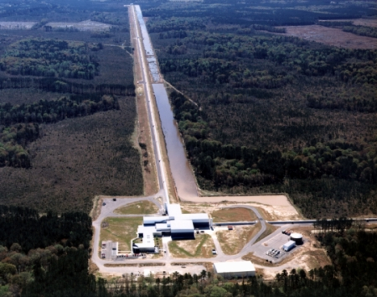
Ground Based Interferometers
Several ground based interferometers are now operating or are being built –
LIGO – US project. Two 4km and one 2km detector.
GEO – British/German project. One 600m detector.
VIRGO – Italian/French project. One 3km detector.
TAMA – Japanese project. One 300m detector.
AIGO – Australian project. One 80m detector.

Slide 19
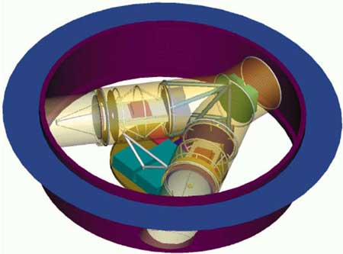
Space Based Interferometers
A space based interferometer, LISA, is planned
Joint NASA/ESA mission.
Will consist of three satellites in a heliocentric, earth-trailing orbit.
Longer baseline (5 million km) gives sensitivity to lower frequency gravitational waves.
Launch date is 2013.
LISA will be a true GW telescope – confusion between multiple sources dominates over instrumental noise throughout much of the spectrum.

Slide 20
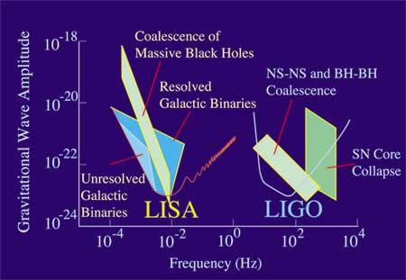
Interferometers - Sources

Slide 21
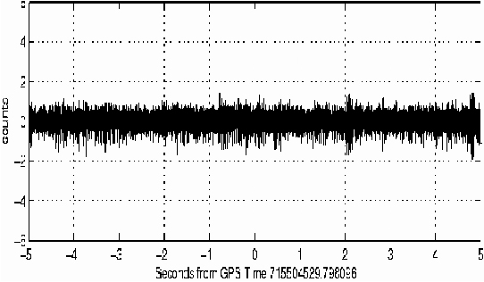
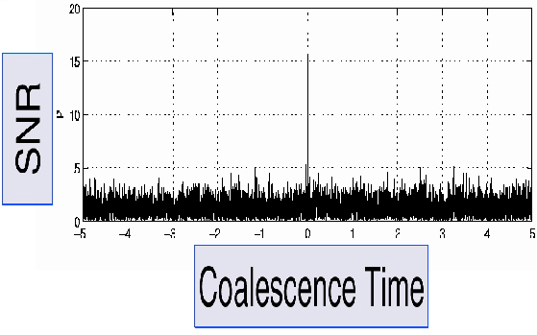
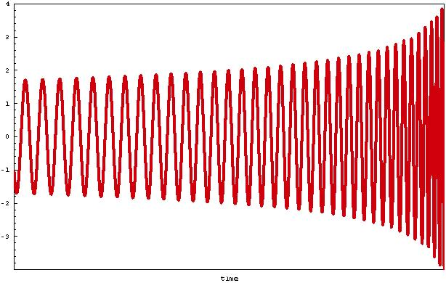
Difficulties in GW detection
Gravitational waves are very weak and weakly interacting.
Events are faint, typically an order of magnitude below the noise.
Detection will be by matched filtering using a bank of templates.
Overlap of template with data pulls signal out of the noise.
+

Slide 22
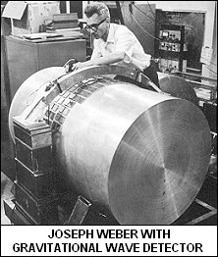
“GW detections” to date - Bars
In the late 60s/early 70s, Joseph Weber claimed to have made coincident detections in two detectors, 1000km apart. The claim was never verified and is regarded skeptically.
In 2002, the EXPLORER and NAUTILUS teams announced an excess of events towards the galactic centre.
These results are highly controversial, even though no claim of a “detection” was actually made
The statistics used in analysing the data are extremely suspect

Slide 23
THANK YOU
By MANDEEP SINGH
TATHAGATA KARMAKAR

